Slide 1
Random effects: What they are, how to use them
Basic “fixed-effects” linear model: Y = mx + b + e
Assumptions e ~^{iid} N(0,var²):
Linear relationship Y and x
Error “e” is normally distributed
Error “e” has constant variance
Data is independent
Non-independence – common causes
Clustered data from assignment of treatments
Replication: location, time, blocks
Repeated measures within experimental unit
Non-independence must be accounted for through random OR fixed effects
Fixed effects (FE): Models means (i.e., yield at each site). FE are “expensive” (9 sites = 8 DF).
Random effect (RE): Models variability of a categorical variable (i.e., yield variability across sites). RE are “cheap” (9 sites = 1 DF).
Basic “mixed-effects” linear model: Y = mx + b + R + e
R ~^{iid} N(0,var_{R}²) AND e ~^{iid} N(0,var_{e}²)
Example: (yield~seeding rate replicated across 5 sites)
How to determine hierarchical random effects? Draw out your experimental design!
Variance of sites is accounted for when looking at model error “e”
This is a random intercept model,
you can also have random slope
e = sum( )
Experimental
design
Data
Fit models &
check residual plots
Site (2)
Types of random effects
Crossed RE (1|Site) +(1|Year) - both REs at the same “level,” (both sites in both years).
Nested RE (1|Site/Block) - lower RE is “within” another. Block 1 in year 1 is NOT equivalent to block 1 in year 2.
Block (4)
Think about experiment and before making model
Cover crop (5)
Mulch biomass
Create a combined variable that looks at variability across 2*4 = 8 groups
Year 1
Year 2
Year 3
Year 1
Year 2
Year 3
Fertility (3)
Weed biomass
Yield
Site 1
Site 2
Site 3
B1
B2
B3
B1
B2
B3
B1
B2
B3
Warnings
There must be more than 2 levels of a RE. Ideally , around 10 for structured experiments. 30 for observational studies.
Singularity and/or convergence issues
Singularity: one model term is estimated at zero. Not an issue as long as ANOVA degrees of freedom (DF) are unaffected. If the ANOVA DFs are miscalculated, use the “Kenward-Rodger” approximation. If that doesn’t correct your DFs, don’t use the model.
Convergence: Your computer couldn’t find a stable solution to the math you asked it to solve. Never use models with convergence issues. The only solution is to use a different approach (glmer) to simplify model terms.
WeedBio~Site+CovC*Fertility +(1|Site.Block/CovC)
Cover crop is nested within site blocks, creating a RE looking at variability across 2*4*5 = 40 groups
MulchBiomass~Site+CovC +(1|Site.Block)
RE should be one level above data
Notes:
Examples of where RE are needed:
Test 100 students, 20 each from 5 representative schools. RE = school
Survey given to multiple people from a household, from a set of representative households. RE = household
Animals clustered within farms. RE = farm
Meta analysis: observations from several research studies. RE = research study
Plate a test-tube in triplicate. RE = test tube

Slide 2



Levels of reproducibility
Data and code:
Code that runs from top to bottom
File structure:
README.txt file explaining metadata (units, date location, etc.)
Universal files (.txt instead of .docx, .csv instead of .xlsx, etc.)
File storage
Opensource and stable (DIO, not associated to a personal account)
Standard labeling {Janitor} package (video)
Software (preferably opensource) and package version {renv} (video)

Slide 3
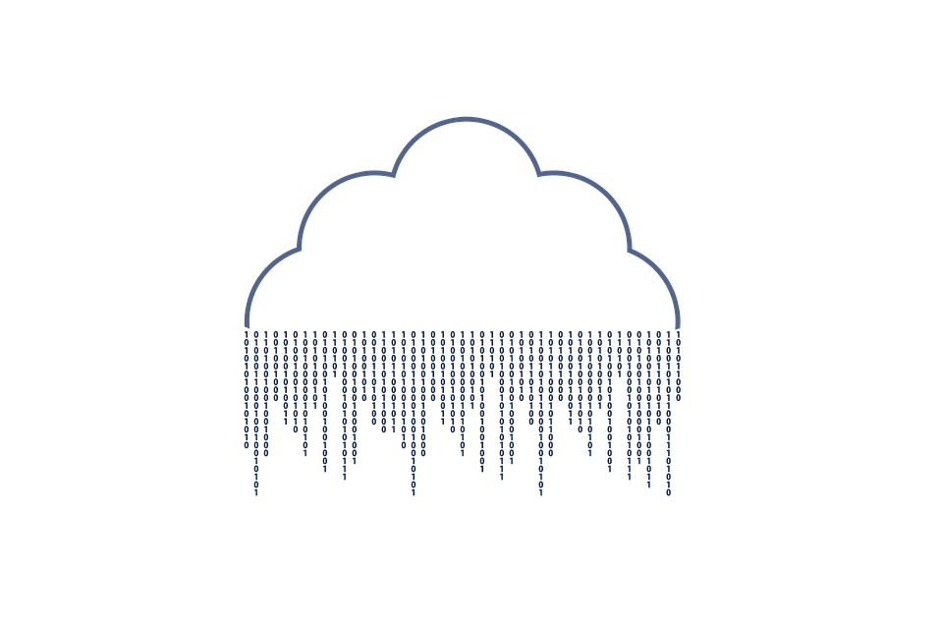
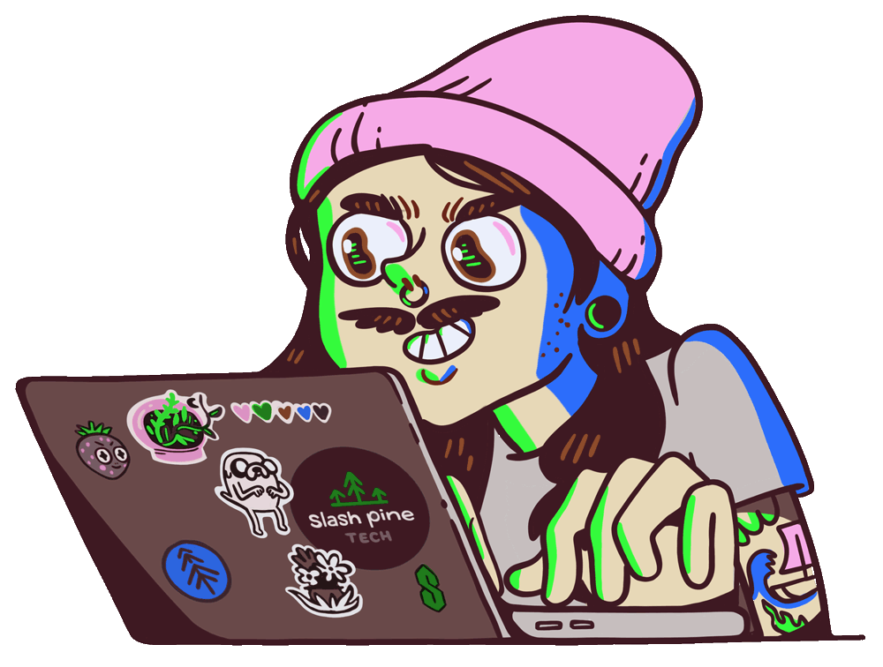
What is GitHub?
Cloud-based storage for your data analysis
Facilitates revision tracking and collaboration
Often used to share data analysis projects

Slide 4
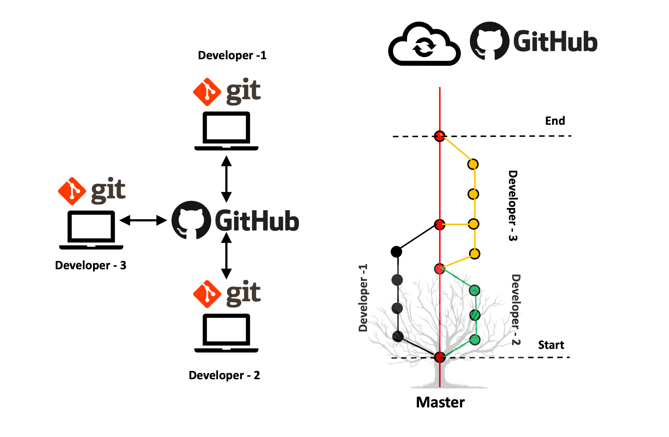


Slide 5
Personal computer
git add (automatic w/t “save”)
Staging area (comments)
git commit
git clone
git pull
git push
Repository (GitHub)

Slide 7

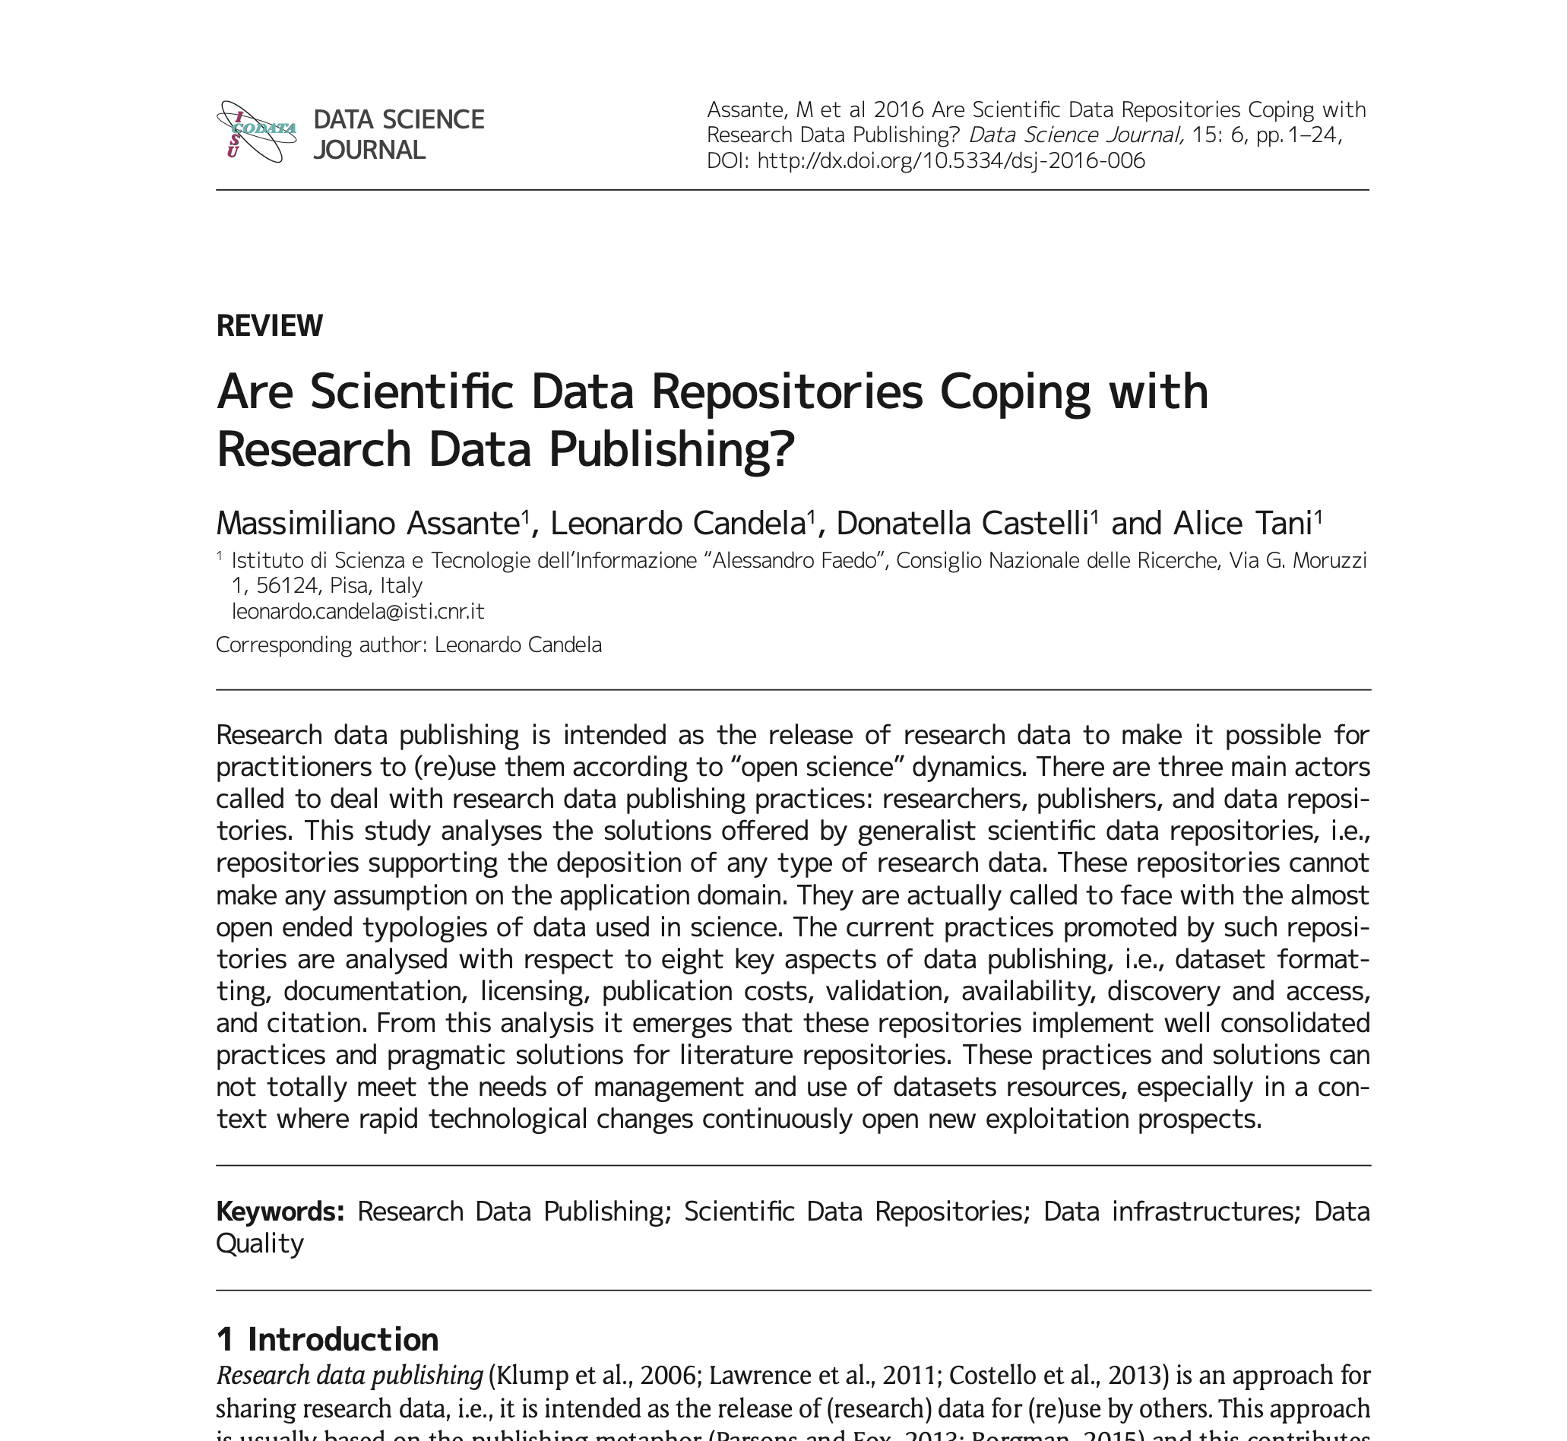
One-time fee, non-profit. Curation.
Free, funded by the EU and hosted by CERN. No curation.
Free, funded by VT. Curation.

Slide 8
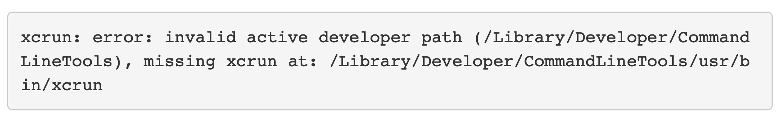
How to install GitHub in R
Make GitHub account
library(usethis) # install.packages("usethis")
use_git_config(user.name = "jules32", user.email = "jules32@example.org")
Generate a Personal access tokens (PATs) to let GitHub interact with Rstudio
create_github_token()
give the token a descriptive name (in the NOTE field), because one day you might have multiple PATs
click “Generate token”
Save PAT!!! I use Apple passwords, a note app also works. If you goof this up and lose your PAT, just generate a new PAT but to not confuse yourself, delete the lost token
library(gitcreds) # install.packages("gitcreds")
gitcreds_set()
Macs that get the error bellow should Install XCode Command Line Tools as described here

